Slide 1

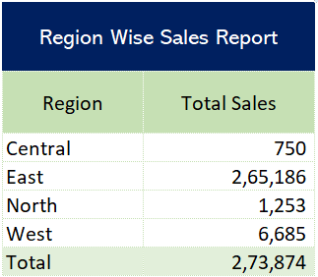
Project-18
SumIfs With Date

